Slide 1
Program 1 Discussion

Slide 2
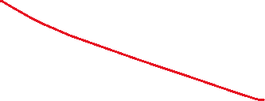
Matching
Is this fair?
Is this centralized or distributed?
a
A
b
B
Notice how our method would assign partners

Slide 3
Centralized Matching Suppose, for example, that we allowed a centralized broker to make the decisions (given the relative preferences). The marriage r wants to make the partners happy, but also wants as many pairs as possible. So for example
A multiagent solution would be
a2 is paired with X2
b1 is paired with W1
c is paired with None
The broker might prefer:
a3 is paired with V2
b1 is paired with W1
c1 is paired with X3
Applicant’s Preferences
W: b,c,a X: b,a,c V: b,a
Employer’s Preferences
a: W,X,V b: W,X,V c: X,W,V

Slide 4
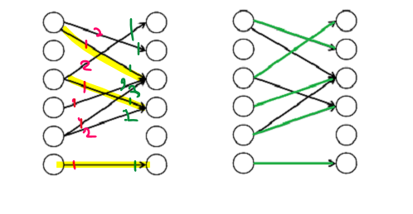
In this programming assignment, we will explore the difference between an agent-based solution and a centralized solution. Motivating Example: Consider matching partners. Which is more important making as many matches as possible (but may not be stable) or making the happiest matches?

Slide 5
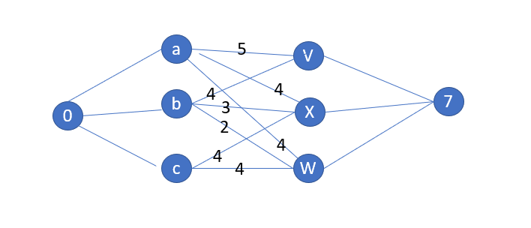

Slide 6
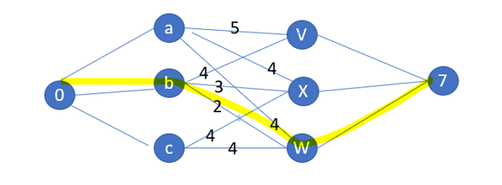
Paths found in order 0 b W 7 (flow 1) totalCost 2

Slide 7
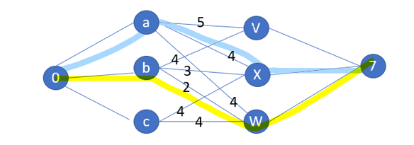







0 a X 7 (flow 1) totalCost 4

Slide 8
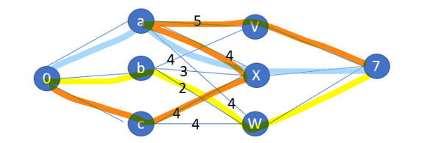
0 c X a V 7 (flow 1) totalCost 5

Slide 9
Output:
a. For files Employers1.txt, Applicants1.txt,(and Employers2.txt, Applicants2.txt)
Using stable matching, show the matching provided with Employers proposing.
Using stable matching, show the matching provided with Applicants proposing.
Using min cost max flow, show the matching provided.
b. For data files you create
Using stable matching, show the matching provided with Employers proposing.
Using stable matching, show the matching provided with Applicants proposing.
Using min cost max flow, show the matching provided.

Slide 10
Hints:
Do read the code that has been provided. It creates adjacency, residual, and cost matrices.
For the min cost max flow algorithm, store edges in an adjacency matrix. Use a residual matrix to store the remaining flow.
Store costs in another matrix where the cost of an edge is the sum of the preferences.
You will want to use Ford Fulkerson algorithm.
You will want to use Bellman Ford as a shortest path algorithm as it accommodates negative edge weights. This has already been implemented for you in the starter code.

